Slide 1

Novin Changizi
Melissa Khuat
Clarissa Song
Jiarui Guo
Notes:
Novin Changizi: research, task development, writing
Melissa Khuat: design, research, project manager
Clarissa Song: storyboarding, research, ideation
Jiarui Guo: storyboarding, research, ideation

Slide 2
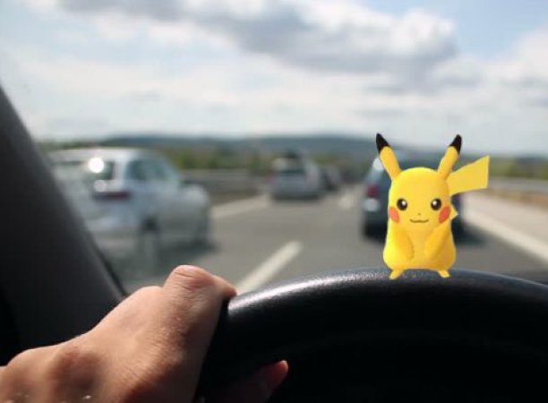
How many of you have ever engaged in distracting behaviors while driving?

Slide 3
Problem
Distracted driving as a result of:
Texting,
Calling,
Scenery,
Makeup,
Drinking,
Exhaustion...

Slide 4
94% of crashes are driver-related
Leading cause = recognition error
Recognition error =
error due to driver inattention and internal/external distractions
Notes:
According to the U.S. Department of Transportation:
Not Environment or vehicle related
According to the result of National Motor Vehicle Crash Causation Survey by the U.S. Department of Transportation spanning from 2005 to 2007, 94 percent of the total 2,189,000 crashes within the 2 years was driver-related, and among those crashes recognition error was ranked as the number one critical reason [1]. The survey defined recognition error as error due to driver’ inattention, internal and external distractions and inadequate surveillance. In another word, the number one cause of motor accident is distracted drivers.

Slide 5
How bad can it be?
Each day in the United States, over 1,161 people are injured and over 8 people are killed in crashes that are reported to involve a distracted driver.

Slide 6
How can we encourage safer driving habits?

Slide 7

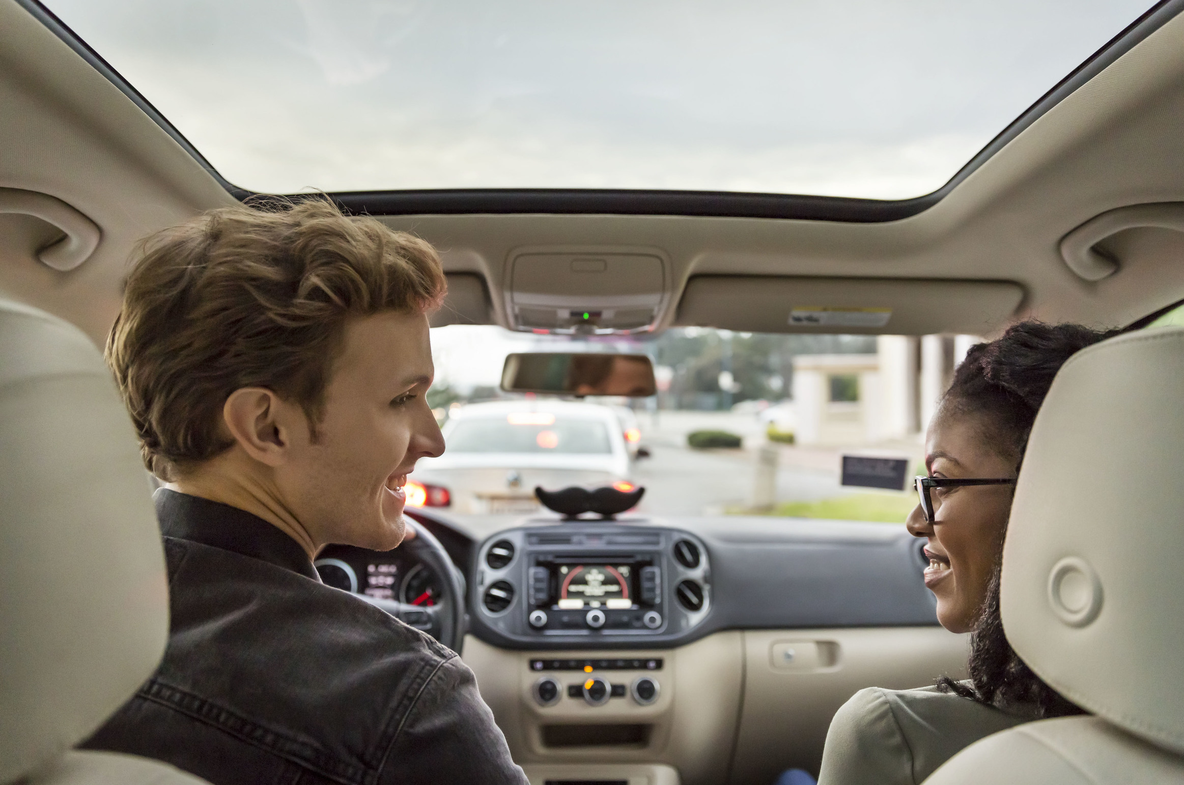
Design Research: Methods
Interviews
Fly-on-the-wall observation

Slide 8

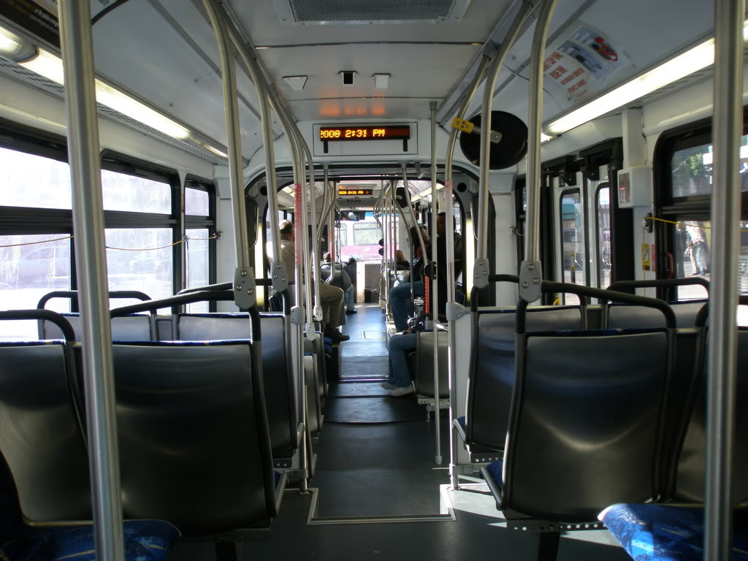

Design Research: Participants
Professional: drive instructor, bus driver
Casual: experienced driver, inexperienced driver

Slide 9
Design Research: Takeaways
Mobile devices are major distractions
Passengers encourage safer driving
Drivers are not aware of how much time they are distracted
Audio and voice controls are not highly distracting
Users are concerned about privacy
Notes:
Mobile devices are major distractions
Passengers encourage safer driving (play a huge role! Very big influence)
Drivers are not aware of how much they time distracted, but do know that they aren’t perfect
Audio and voice controls are not highly distracting
Users are concerned about privacy

Slide 10
Tasks
Learning consequences of distracted driving
Receiving alerts of distracting behavior while driving
Sharing and comparing safe driving habits
Tracking eye and body movements of driver in real-time
Processing and visualizing data on driving behavior
Monitoring driving behaviors in employees/children

Slide 11
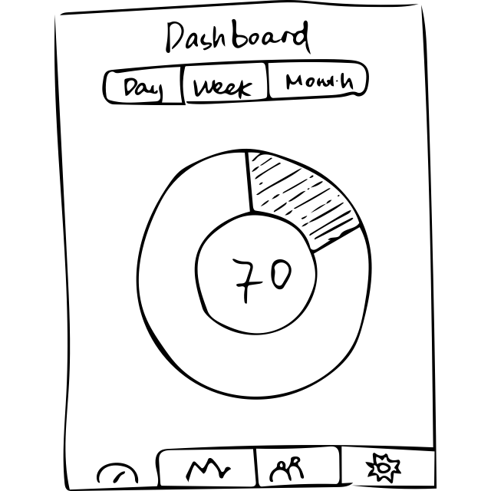
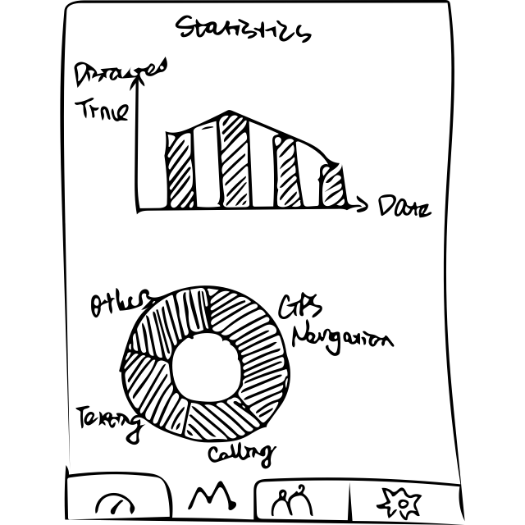
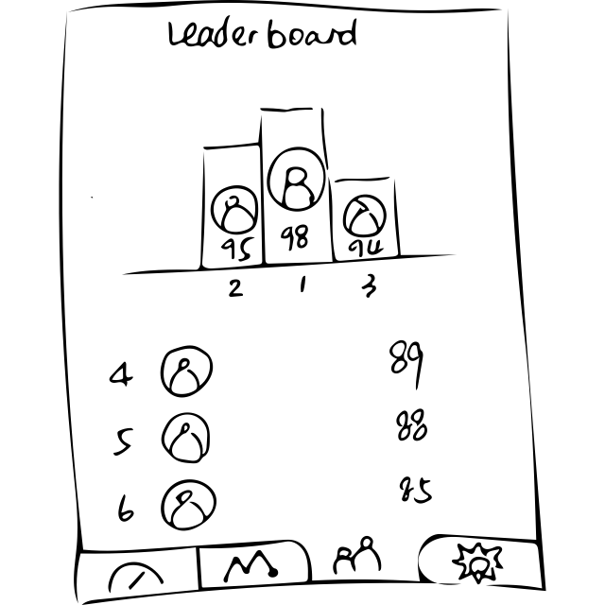
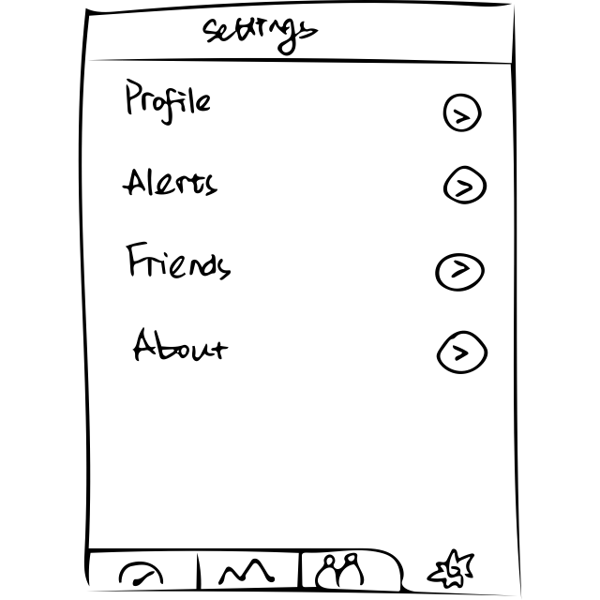
Design 1
STAND-ALONE MOBILE APP

Slide 12

Design 1
STAND-ALONE MOBILE APP

Slide 13
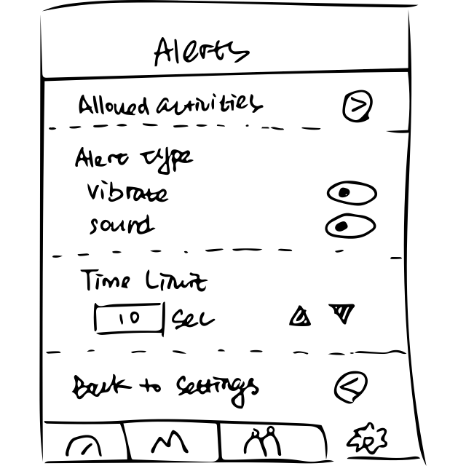
Design 1
STAND-ALONE MOBILE APP

Slide 14
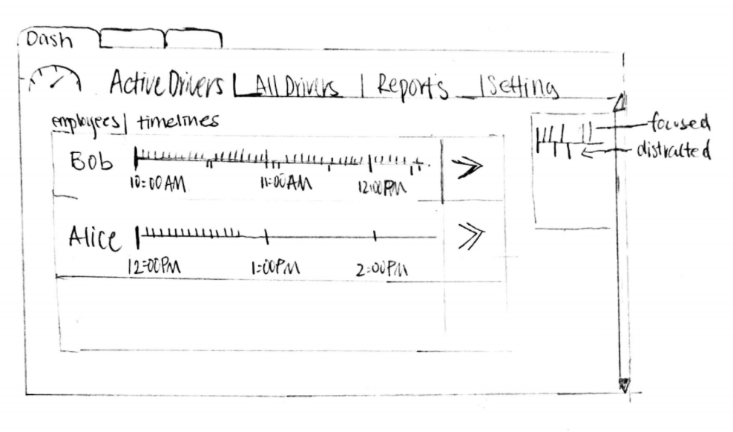
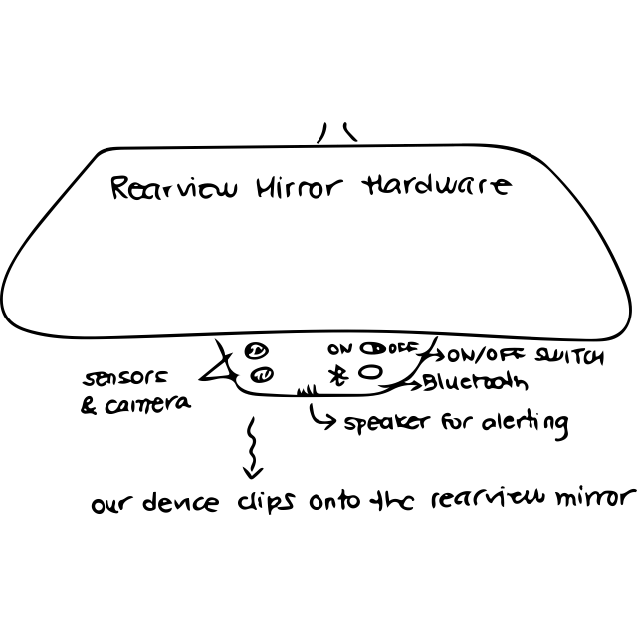
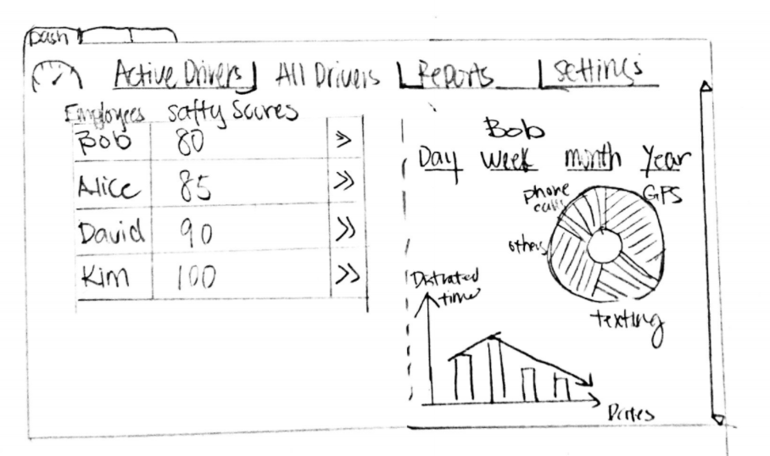
Design 2
MONITORING HARDWARE & WEBAPP

Slide 15
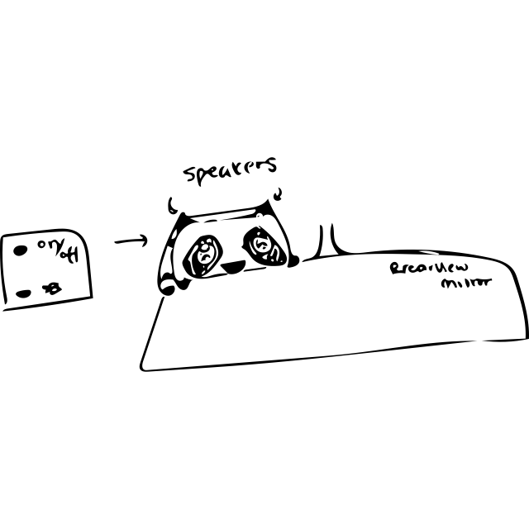
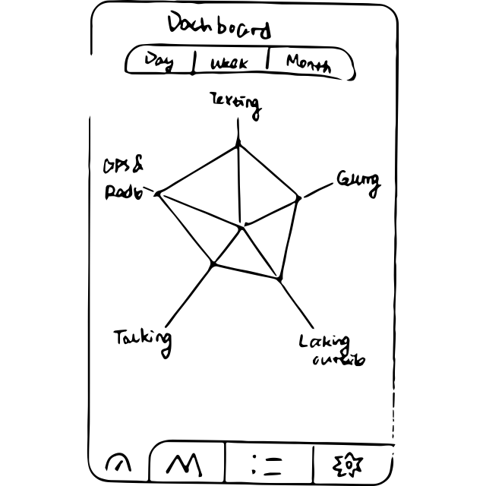
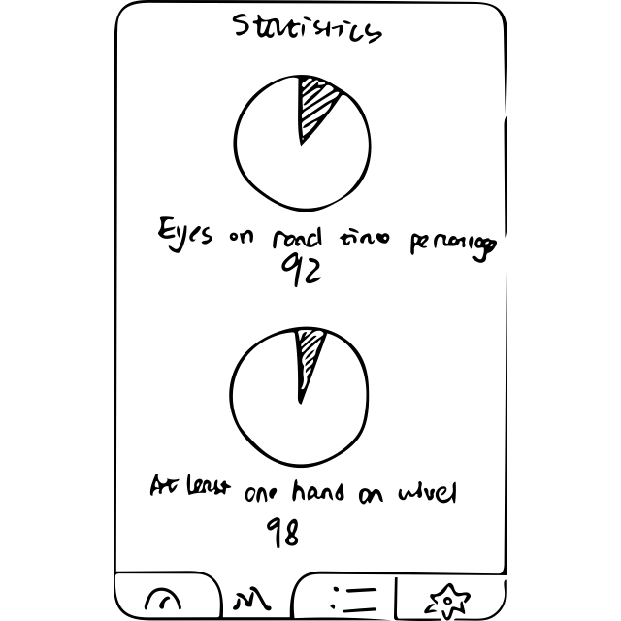
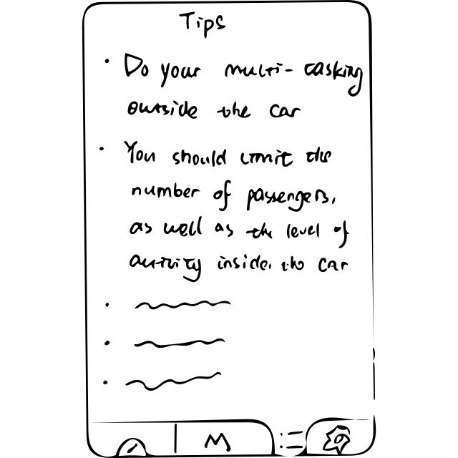
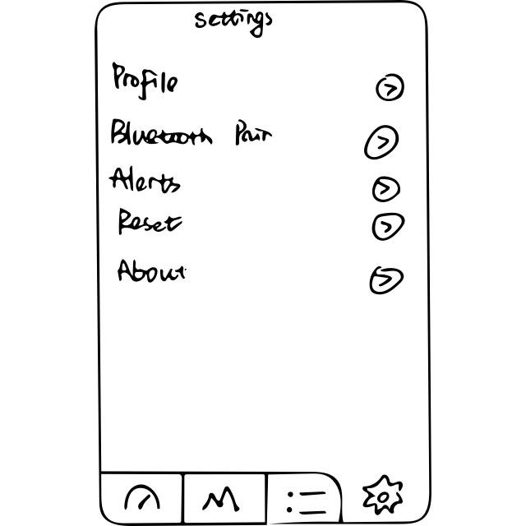
Design 3
TRACKING HARDWARE & MOBILE APP

Slide 16
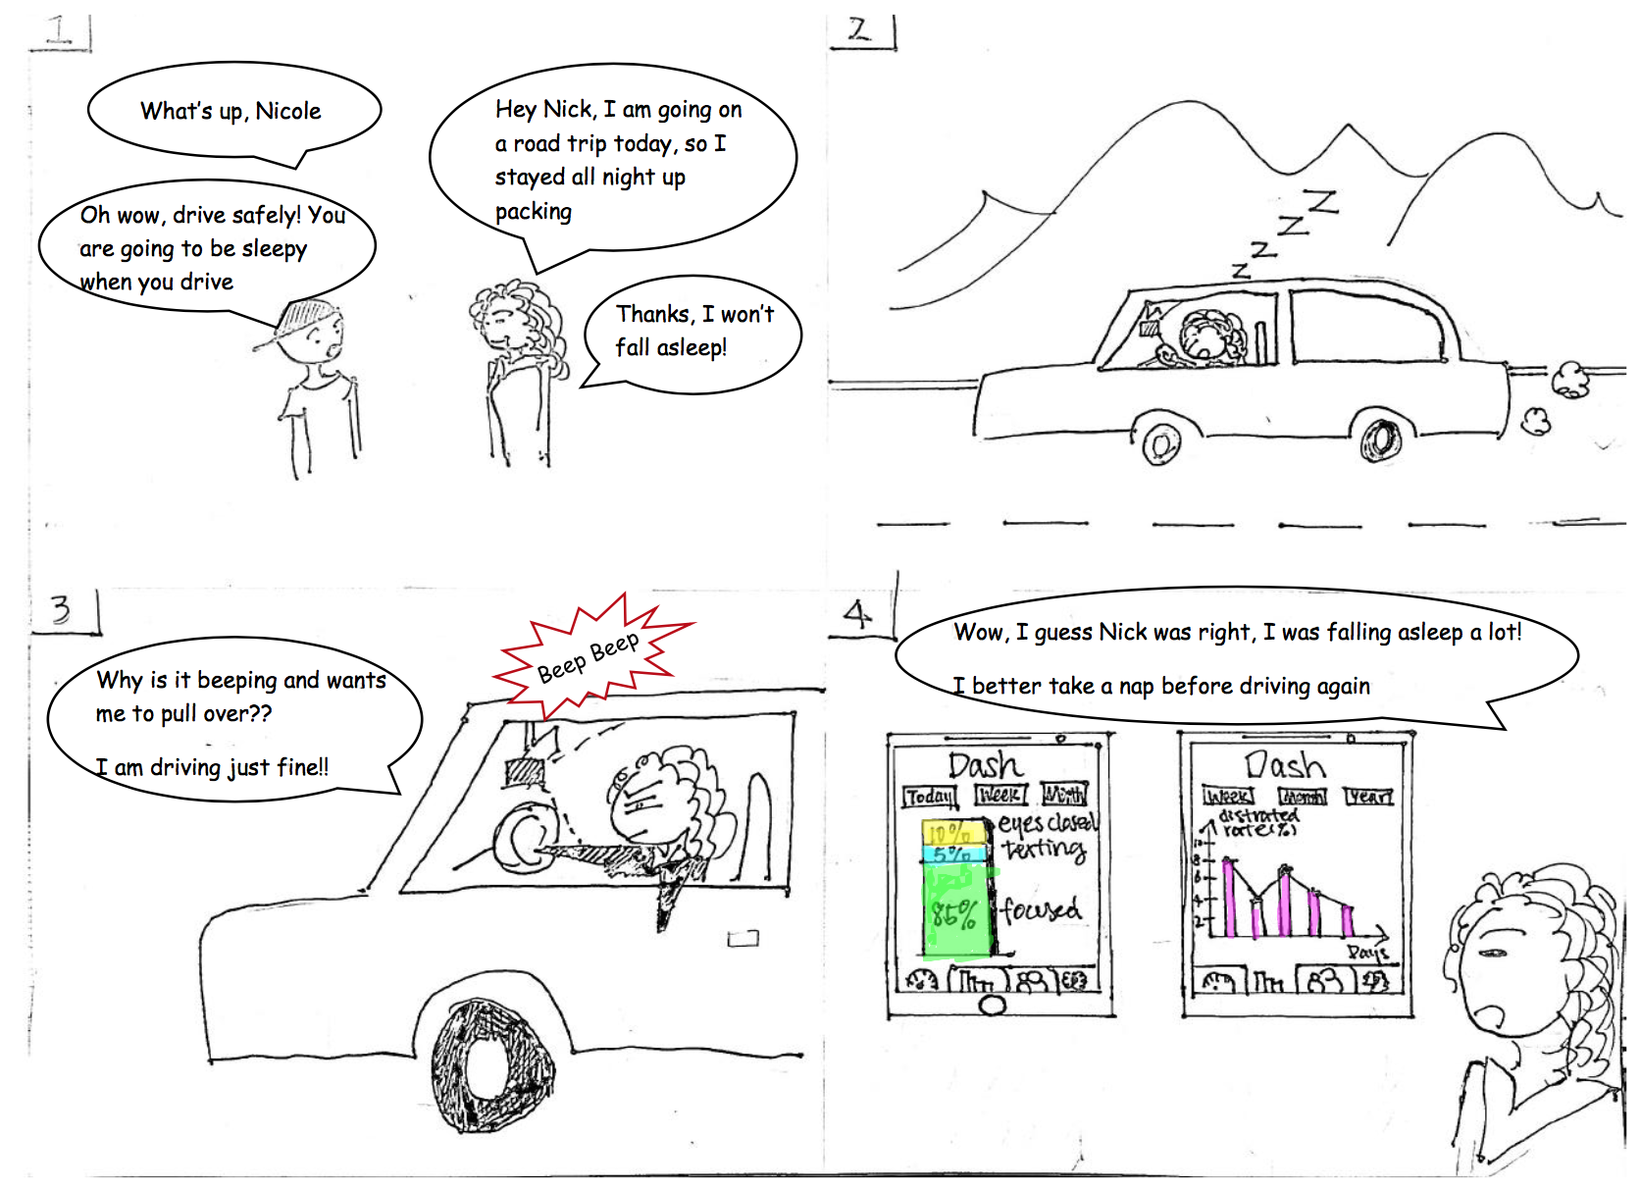
Storyboard 1
PROCESSING & VISUALIZING DATA ABOUT DRIVING

Slide 17
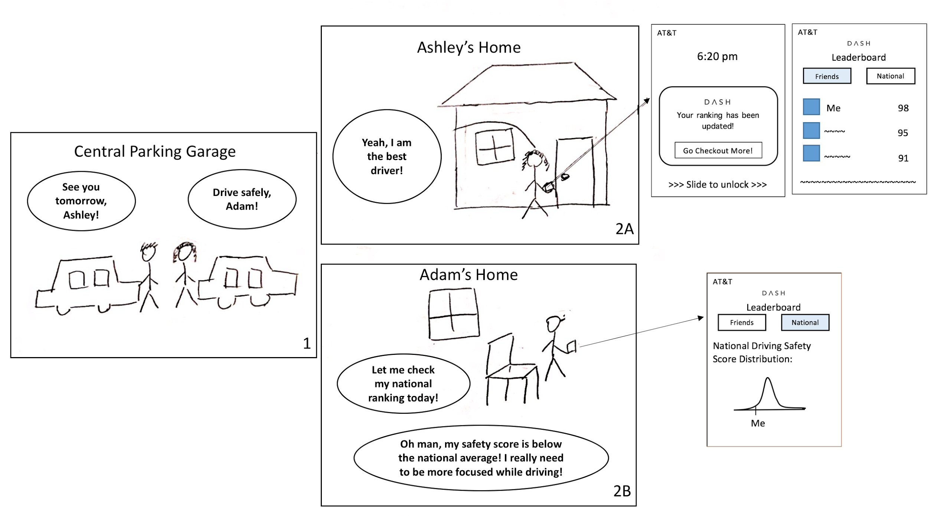
Storyboard 2
COMPARING & SHARING DRIVING HABITS

Slide 18
Summary
Flexibility and communication is key for teamwork
Research before designing
Iterate through many sketches--evaluate them all!
Don’t sweat the small details about implementation

Slide 19
Questions?

